Slide 1
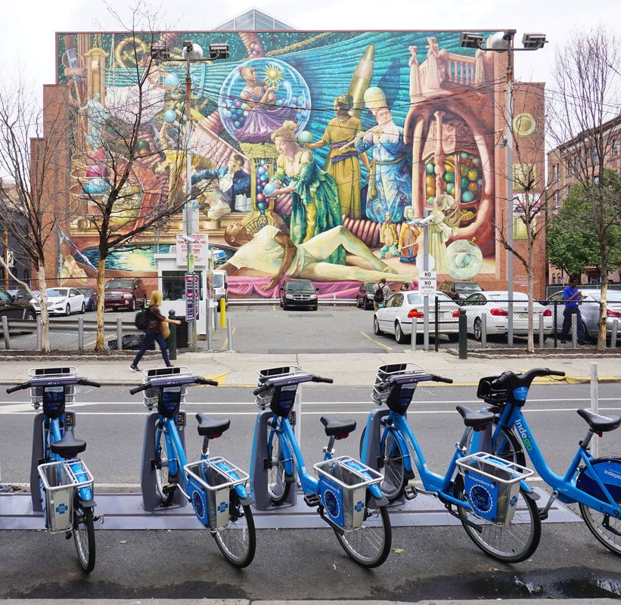
Improvements To Worker Assignment Problem
Trent Johnson
Georgia Institute of Technology
Department of Mathematics
Jie Wu
Temple University
Department of Information and Computer Sciences

Slide 2
Table of Contents
What is Bike Sharing
Rebalancing Problem
Ways to solve Bike Rebalancing
Worker Assignment Problem
Algorithms for Worker Assignment Problem
Comparison of Algorithms
Summar

Slide 3
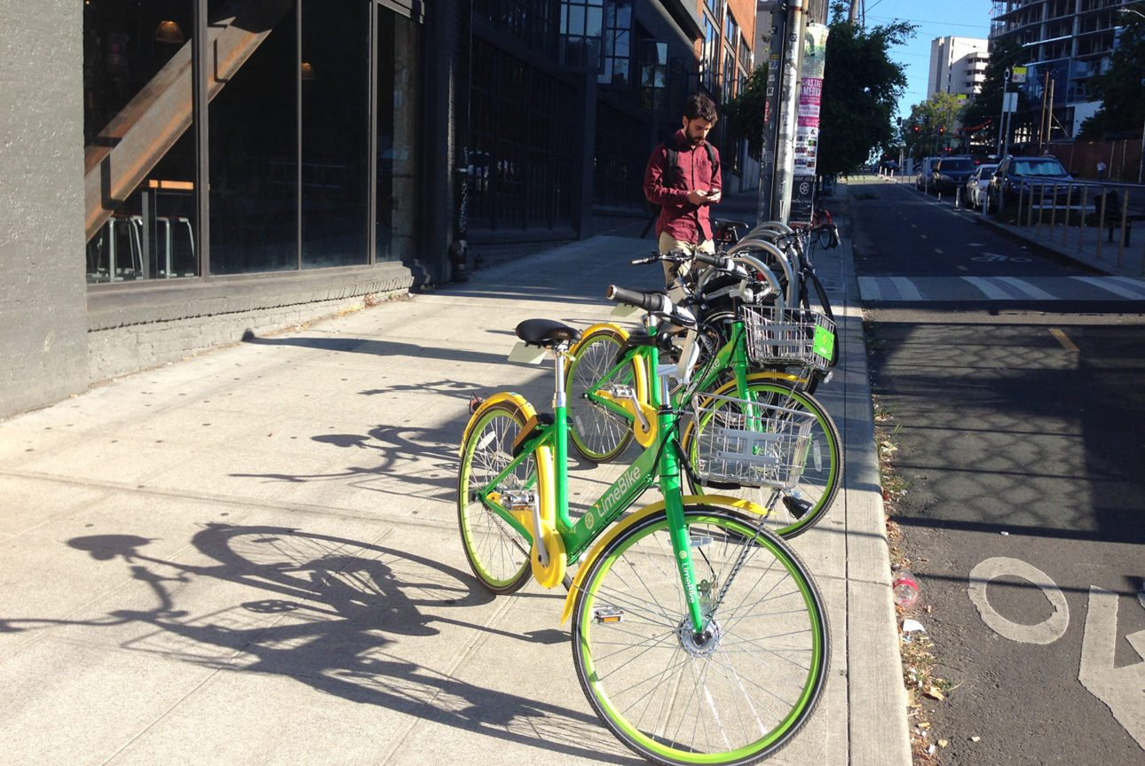
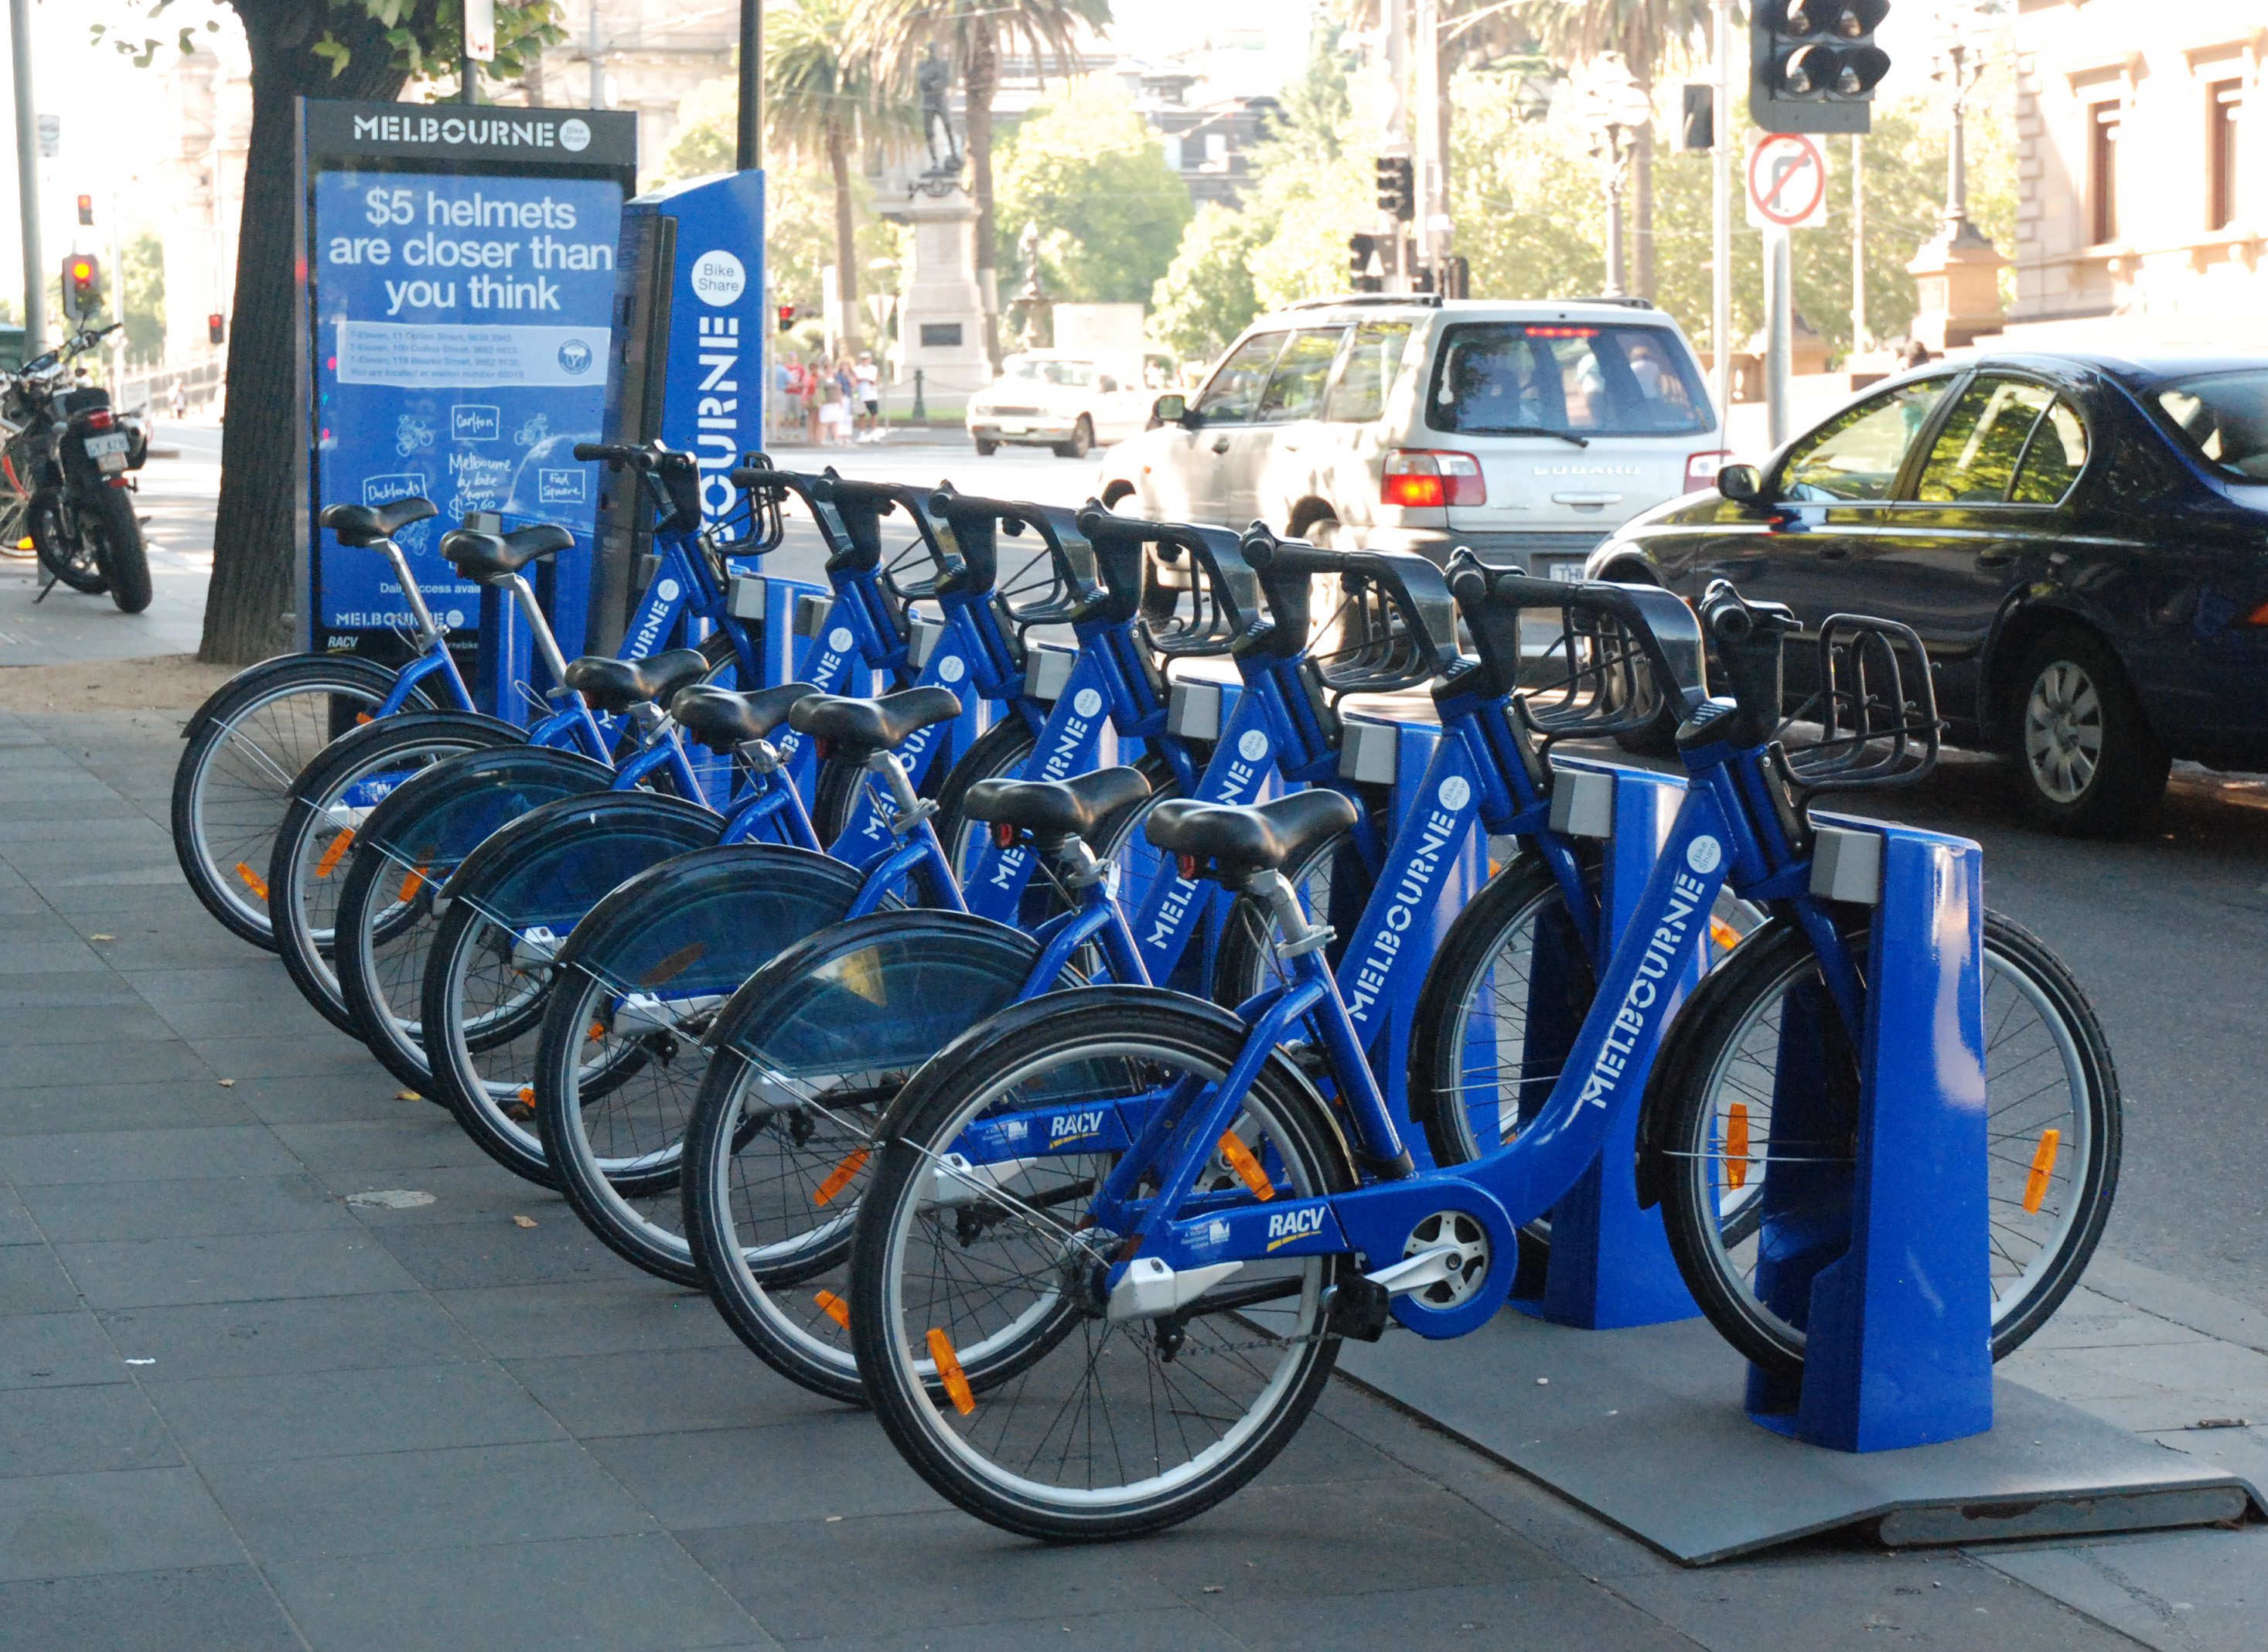
What is a Bike Sharing System
Bike Sharing Systems (BSSs)
Docked vs Dockless
Benefits
Exercise
Eco-Friendly
Reduce Traffic
Cheap
Low Infrastructure Public Transportation
Alta Planning + Design. LimeBike in Seattle, Washington. Seattle
K, P. (n.d.). Melbourne City Bikes. photograph, Melbourne.

Slide 4
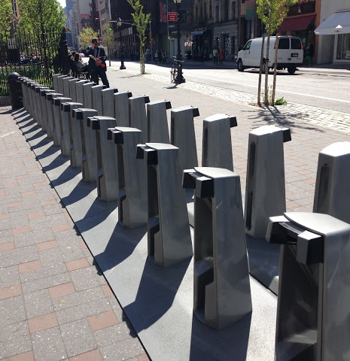
What is Rebalancing?
Demands for stations change with location and time
Overflow/Underflow station- stations with too many or not enough bikes
Gwenneth Leech. Empty bike docking station at Spring and Lafayette. New York City

Slide 5
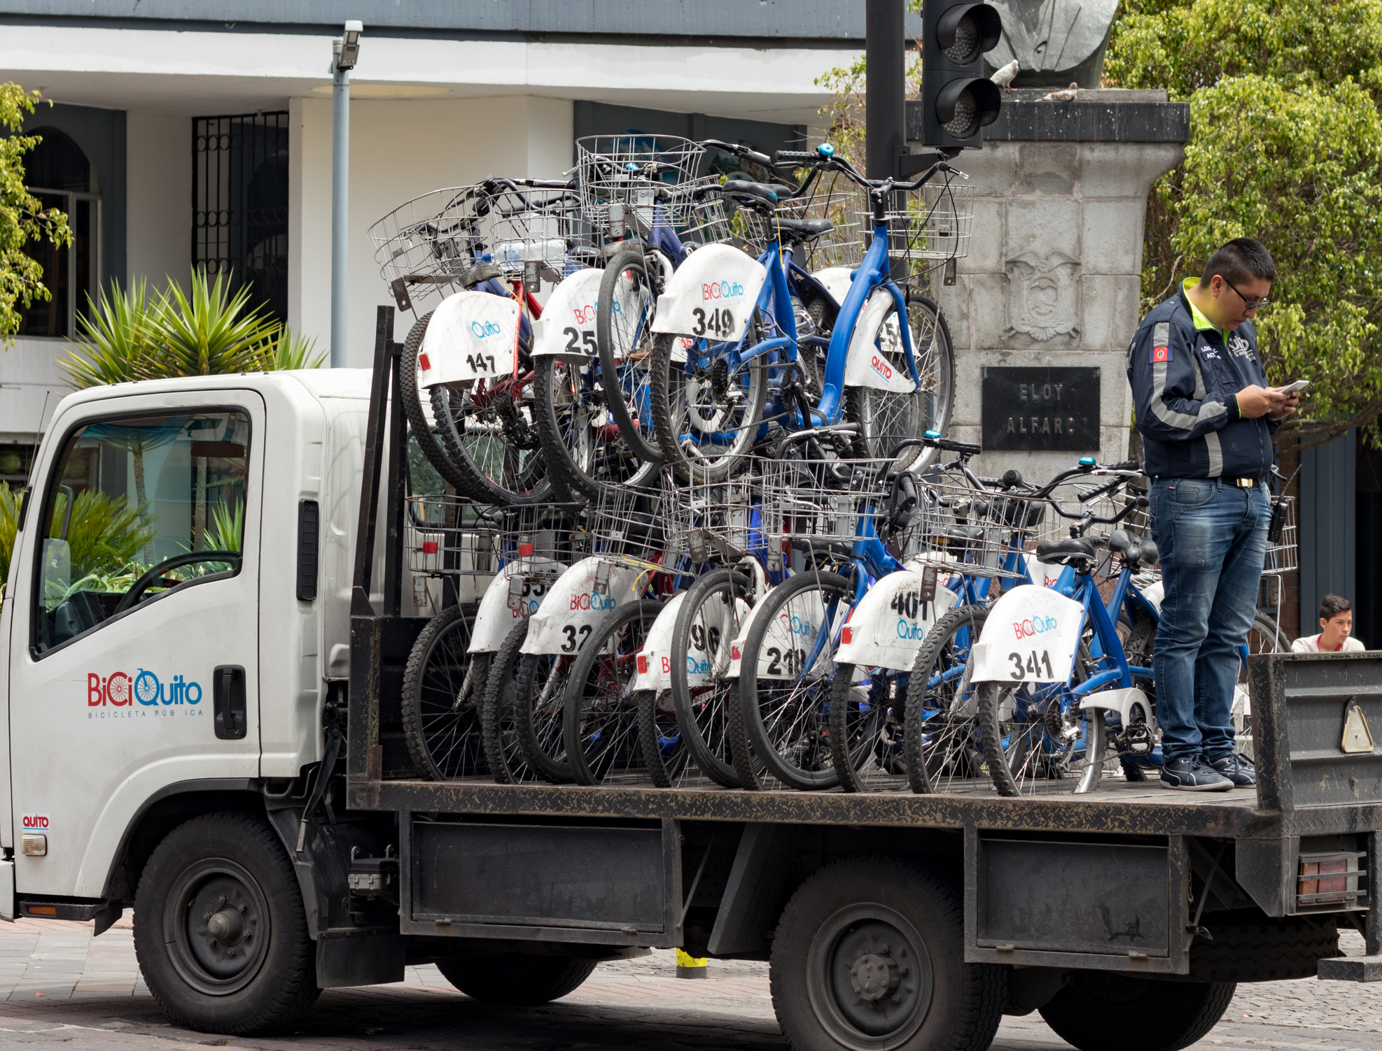
Trucks for Rebalancing
Optimal Hamiltonian Path
Traveling Salesman
Advantages
Centralized
Controlled
Disadvantages
Expensive
Cause Traffic
Pollution
Ted Timmons. BiciQuito bikeshare rebalancing truck. Quito

Slide 6
Crowdsourcing with Users
Use existing users to rebalance stations
Incentive Model
Have “prices” for stations that need rebalancing
Any user can rebalance for the reward to a station of their choice
Assignment Model
Hire workers to rebalance whenever they use the BSS
Assign workers station rebalace

Slide 7
Spatial vs Temporal
Rebalancing can be divided into separate spatial and temporal problems
Temporal
Divide the day into time slices
Predict workers and station demands in the time slice
Spatial
Create incentives/assignments based on predictions

Slide 8



Worker Assignment Problem
Create optimal assignment of worker to stations
Same overflow targets and underflow targets
Variable number of Workers
Partial Assignments
NP-Hard

Slide 9
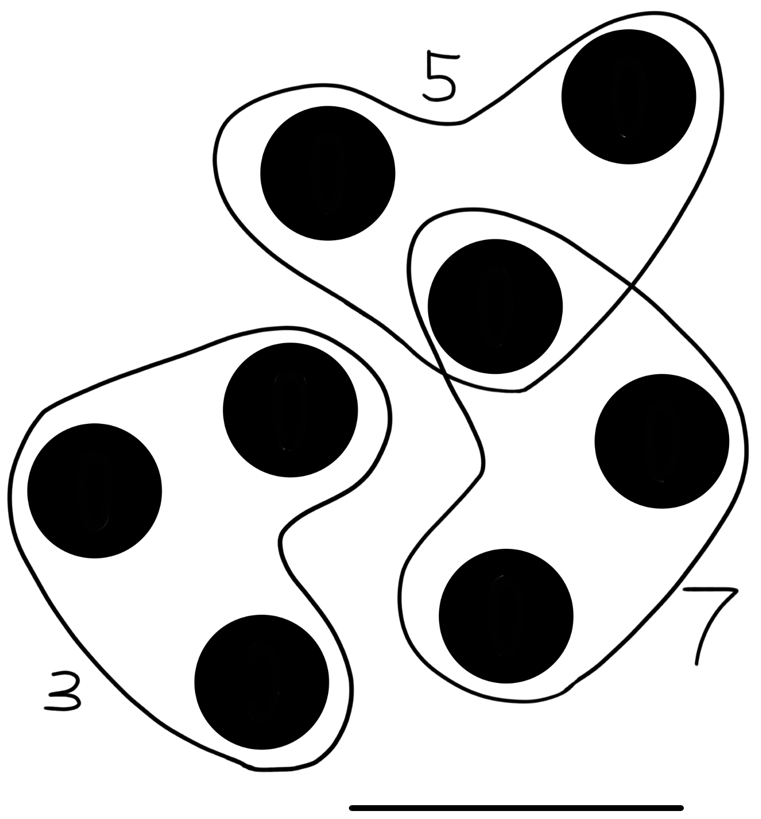




3-Dimensional Matching
7
Graph Matching- Find a collection of disjoint edges in a graph with maximal weight
Polynomial Time with Hungarian Method
3D Hypergraph- Graph with edges that connect three vertices rather than two
3-Dimensional Matching- Find collection of disjoint edges in a graph with maximal weight
NP-Hard
3
5

Slide 10
Algorithms

Slide 11
Two Round Matching (TRM)
Round 1: Create overflow underflow station matching
Round 2: Create worker station pair matching
Hungarian Algorithm
O((MN)log(N))

Slide 12
Hungarian Search (HS)
Iteratively fix sections of the graph
Perform a matching on the constrained graph
Random Hungarian Search
Random graph optimized with HS

Slide 13
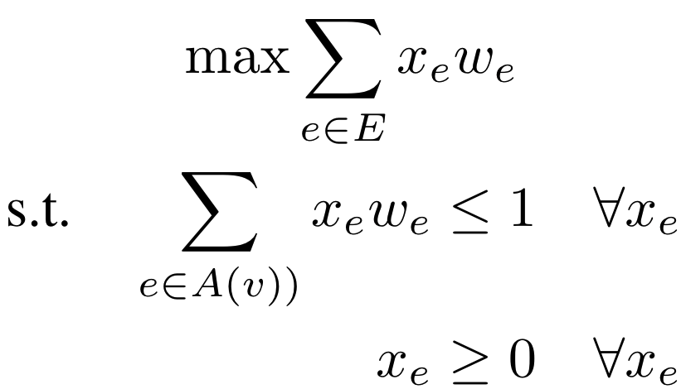
Local Ratio (LR)
Creates an order of edges via Linear Programming
Local Ratio- Recursive subroutine
Prunes bad edges
First finds how much each weight each edge adds compares to edges around it
Gets graph from recursive call
Adds first edge in ordering to matching if valid

Slide 14
Initialized Round Search (IRS) (Proposed)
Make an approximate graph with TRM
Run HS on the results
Combines the rapid speed of TRM with iteration and performance of HS
Still 3-approximate

Slide 15
Experiment

Slide 16
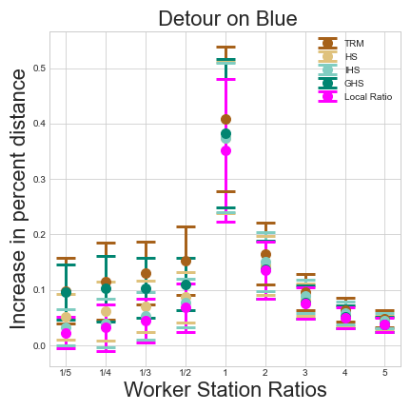
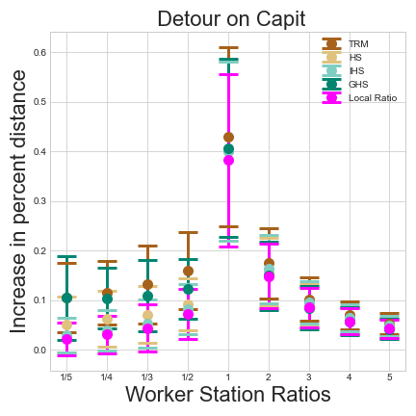
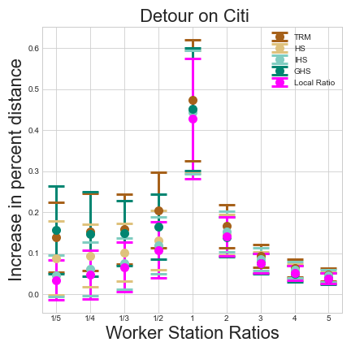
Detour Distance

Slide 17
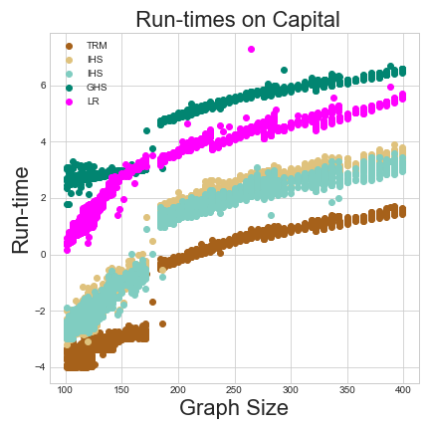
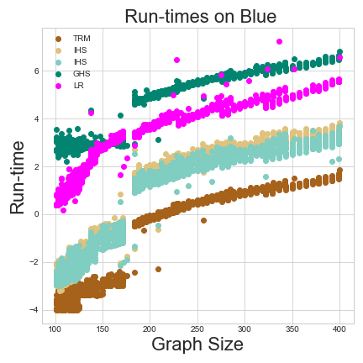
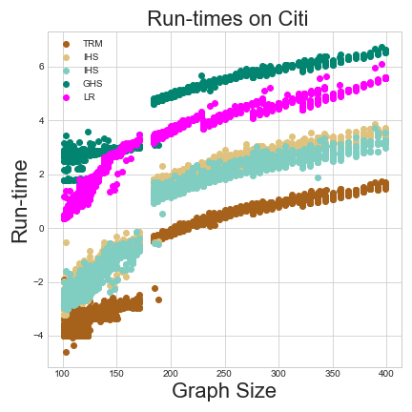
Run-times

Slide 18
Conclusion
IRS imilar performance at reduced runtimes
Better suited for real time applications
Can be adapted to help inform incentive models for more personalized incentives

Slide 19
Questions?

